Slide 1



MOOSIC
Your Mood.
Your Music.
19.09.2023
Capstone Project
Neuefische Data Practitioner
Notes:
Thank you, XY!
Hello everyone and welcome to our capstone project presentation!
We want to present to you Moosic a music recommendations system that combines Mood and Music - to give you the best experience in listening to music.

Slide 2




Meet the team - Rhythm Byte Engineers
Shahi
Christian
Grace
Notes:
We are:
Shahi a graduate linguist and data practitioner,
Christian a Site manager for fiber optic cable technology and data practitioner
and Grace a graduate industrial mathematician, applied research scientist and data practitioner

Slide 3
Intro
Idea and Vision
Notes:
How did we come up with our project idea?
We were talking about how unsatisfied we are with the music recommendations we get from Spotify or other music streaming platforms.
When we talked about why we don’t like the recommendations we figured out, that the same songs were proposed partly repeatedly or the tracks didn’t fit the mood we were in or the activity we were engaged in.
By thinking of ways how to tackle these problems we came to the conclusion, that it would be nice to have some kind of user input, to make the track recommendations fit the user preferences. We then pinpointed the two features mood and genre to act as filters for better predictions.

Slide 4



The Problem - Mood
59% of people often face difficulty in finding playlists according to their mood ¹
1 Survey by Anumeha Jain:
https://medium.com/@jainanumeha74/spotify-ux-research-case-study-68997acf20f1
‹#›
Notes:
Why did we go with these two features mood and genre?
The problem with music recommendations at present is that the recommended tracks often times don’t fit the listeners mood.
For example Spotify uses a complex system of a variety of factors to personalize the listening experience for each user.
These factors include the user's listening history, their favorite songs and artists, and the genres and playlists they listen to.
The problem is, that mood isn’t tracked. And it’s the most human thing to change moods over the course of time - be it days or hours.
So, when we are sad on one day for example and listen extensively to sad songs, the algorithm is bound to recommend these songs again to the user,
even if the user isn’t in a sad mood any more.
Source
(How Does the Spotify Algorithm work in 2023? The Spotify Algorithm Explained | iSpyTunes: https://www.ispytunes.com/post/spotify-algorithm-explained)

Slide 5
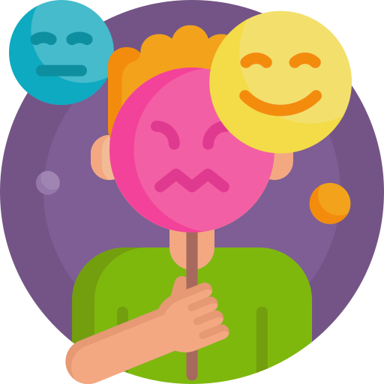

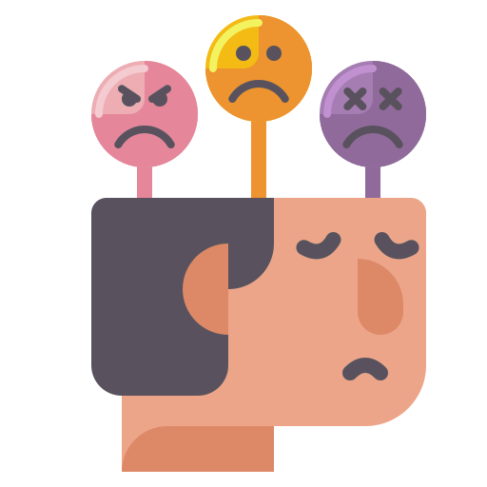

Mood Management
Participants of a study ², conducted by British psychologists, responded that they use music to express emotions and manage their mood.
2 Source: Why do we listen to music? A uses and gratifications analysis by Adam J. Lonsdale and Adrian C. North, p.120. Published in: British Journal of Psychology (2011), 102, 108–134
Notes:
But why is it so important, that music fits our mood?
Participants of a study, conducted by British psychologists, responded that they use music to express emotions and manage their mood.
They used music :
“To put them in the mood they want to be in”, - like feeling sad and wanting to feel better
“To get them into a certain mood or feel a certain way”
“To put them in a particular mood or get them out of a particular mood”
And
“To put them in the mood for something” like learning or working out.
So music becomes a tool for us to manage our moods.

Slide 6

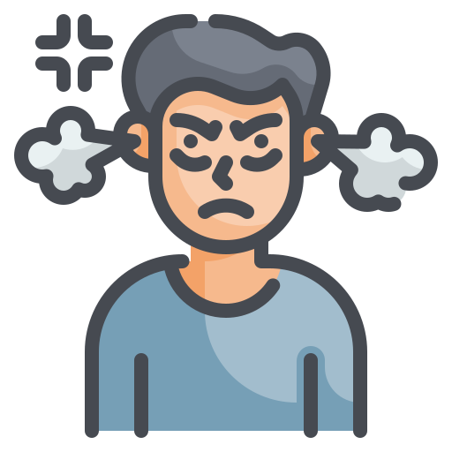
The Problem - Genre
Genre is also a key factor:
I’m listening to more than only my dominant genre!
Notes:
Aside from mood the Algorithm has Another problem: it can't make good song suggestions for people who like to listen to music from multiple genres.
The result is that these users often only get song suggestions from their most dominant music genre.
But they want to enjoy music from other genres as well and therefore demand - from a good recommendations engine - divers recommendations, as they are divers listeners.

Slide 7

Our Vision
For: Individuals, Music streaming platforms
Mood Management
Improve User Experience
Diverse Recommendations
Notes:
Our Vision is
To create a music recommendation engine that allows the user to select a mood goal
This way they can manage their mood
We want to give the user the option to choose a genre so we can give diverse listeners diverse recommendations
With this we want to:
Prevent recommendations based on a dominant genre,
repetitions and
tracks that don’t fit the mood the users want to be in or achieve.
Also the recommendations system is suitable for Individuals as well for Music streaming platforms.
Our overall Goal is to Improve the user experience.

Slide 8



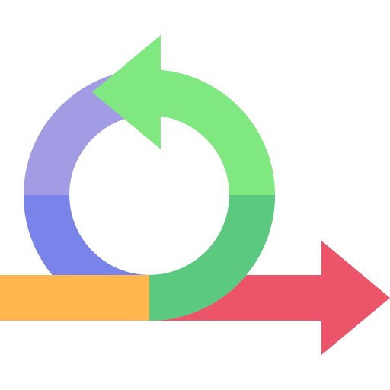









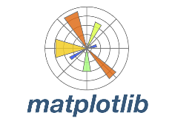






Our Tech Stack
Notes:
Just a quick look at our tech stack. These are the tools we used.

Slide 9


The Data Set - Spotify 600k+ from Kaggle (1.7 Mio entries)
Artists.csv:
1.162.095 entries
Tracks.csv:
586.672 entries
Tracks from 1921-2020
Notes:
I want to give you a short introduction to our dataset:
We used the 600k+ dataset from spotify. It consists of two datasets: the tracks dataset and the artists dataset.
The tracks were from the last 100 years, so we have tracks in our dataset that are from the 1920ies as well from the 2020ies.
(Meta-information
Title: Spotify Dataset 1921-2020, 600k+ Tracks
Subtitle: Audio features of 600k+ tracks, popularity metrics of 1M+ artists
Source: Spotify Web API
Creator: Yamac Eren Ay
Release Date (of Last Version): April 2021
Dataset consists of tracks from the years 1922-2021)

Slide 10
EDA
How did we get our data
Notes:
Thanks a lot Shahi! Now i would like to give you insights to our EDA part, beginning, on how we got to our data.

Slide 11


Getting to the right size
Cleaned
586.672
536.452
15.000
Entries
Samples
Notes:
So, we started with 2 Datasets, the Tracks-Dataset and the Artists-Dataset. Our main focus was on the tracks,
so it would have been fine to just use this data. But since the Artists dataset included not only the artists names, but also their respective genres,
which we needed for our idea, we extracted these features and integrated them into the tracks dataset.
So we ended up with a then merged Dataset, with around 587.000 entries.
Additionally, we performed some data cleaning as part of the process. For instance we found out, that audiobooks were also present in the dataset.
Since we set our focus only on songs, we deleted them, as well as a comparatively, small number of missing values.
We wanted to have proof of concept. Therefore, we started with a smaller amount of data and used 15.000 out of these 537.000 cleaned entries, for training our model.

Slide 12
How an actual track now looks like
- Danceability
- Energy
- Valence
Track Metadata
Audio Features
Engineered Features
- Track ID
- Artist Name
- Genre
- Mood Goal
Notes:
And this is, what our Dataset, now looks like:
It consists of 3 main Parts:
Firstly the track Metadata, which contains all the necessary information about the track, like a track id, Artist and Song name, but also the sub genre, or genres.
Next comes the Audio features. These contain unique Attributes, like Danceability, Energy and Valence, which describes the main characteristic of a song.
And lastly our engineered features, the Genre, which now contains only the single main genre, the song primarily belongs to. And the mood goal.
The Mood goal, shall display which emotional sentiment, u should, or want to be in, after hearing this song. If you choose for example a calm song, you should in the best case bring your mood down to a slackened and easygoing state.

Slide 13
EDA
First insights

Slide 14
Feature Engineering - Genres
Genre combinations:
18.514
Unique subgenres:
7.033
Main Genres:
26
Notes:
After the glimpse of our data, let’s now take a deeper look into our Insights and our engineered Features, starting with the Main Genres.
In our Dataset, we have encountered a little over 18.500 different genre combinations, out of 7.000 unique genres.
This high number occurred not only due to the fact, that there are a vast number of genres, sub and sub sub genres and different styles, but also that there can be multiple genres, a song can belong to.
To work furthermore with our model, we were then in need, to minimise the number of sub genres, which we achieved by extracting, 26 main genres.
This brings me to the overview, on how the main genres are distributed.

Slide 15
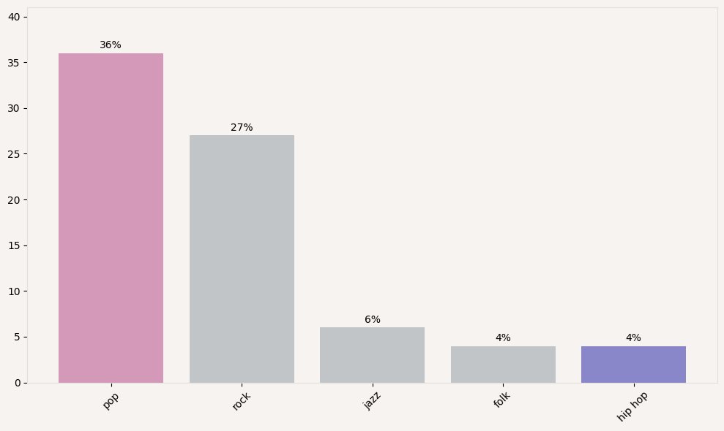
Distribution of the Top 5 Main Genres
Genres
Notes:
As we can see in this plot of the top 5 main genres, POP and Rock are the most dominant Genres with over 60%, followed by jazz, folk and hip hop.
The reason for this majority of pop songs, is founded in the fact, that a lot of songs and genres, fall under this broad umbrella term. So can pop refer to rock, country, hip hop and many more genres.
But also for our second most present genre, Rock, there are more than 30 Sub Genres and even more Styles, and the boundaries to other music genres, are fluid here as well.

Slide 16
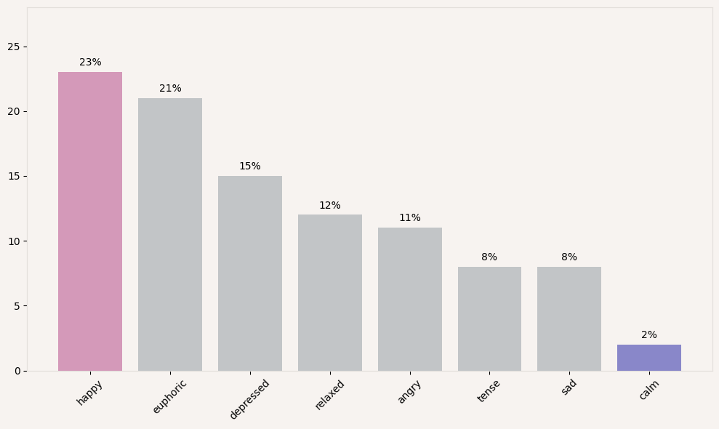
Distribution of the 8 Moods in our dataset
Mood Labels
Notes:
To introduce our second engineered, and main feature, The moods, i would like to present you, also an overview of its distribution.
As we can see, happy and euphoric songs are the most represented with 23 and 21%. Followed by depressed with 15% and then subsequently: relaxed, angry, tense and sad.
And lastly the songs, belonging to a calm mood, are the least presented in our dataset, with a number of 2 percent.

Slide 17
How are the Genres distributed over the Moods?
Tense
pop
rock
metal
others
metal
Calm
pop
rock
jazz
folk
blues
Notes:
Following that, I would like to present, how the Genres are distributed in our Mood Segments, with serving Tense and Calm, as an example.
It's not a surprise that Pop has taken a big proportion for both genres here also.
But what we can also see, Rock is even more present in tense, followed by metal, which are both rather known for a more intense and tautened atmosphere.
While in the calm genre, rock is less present then jazz, and metal takes up almost no space at all. Therefore folk and blues take place, which are more prominent for representing, more serene and relaxed music styles.
I would now, like to hand it over, to Grace.

Slide 18
Feature Engineering
Mood
Mood to Music Track
Notes:
Thank you, Chris!

Slide 19
Mood Feature Engineering
What emotional and physical responses did the tracks evoke for a listener?
Valence:
Does the music track make you feel positive (pleasant)
or negative (unpleasant) ?
Energy:
Do you want to get active when listening to the music track
or do you want to chill?
References: A Connotative Space for Supporting Movie Affective Recommendation by Benini et al. ; A 12-Point Circumplex Structure of Core Affect by M. Yik, J. Russel & J. Steiger. :Emotion Label Enhancement via Emotion Wheel and Lexicon by Zeng et al.
‹#›
Notes:
So how did we engineer our target feature - mood for the music tracks, to do this we used two proposed mood indicators which defines both the emotional and physical response evoked by the music.
These are the valence and the energy features
For more context, the valence feature basically tells us by how much the track gives a positive or negative feeling i .e the level of pleasantness while
The energy is a measure indicating how much a music track makes one go from less active state physically to more active or lots of movement.

Slide 20
Mood Feature Engineering
Energy
Mood labelling validated using :
Modified Russell - Thayer’s model of affect
Plutchik’s wheel of emotion (color - to mood matching)
Elbow method
Eight (8) basic mood categories with umbrella affect terms words defined in the quadrants of the 2-D space
Tense
Q1 : Happy
High energy, High pleasant feelings (Valence)
Happy
Angry
Euphoric
Depressed
Calm
Sad
Relaxed
Valence
References: A Connotative Space for Supporting Movie Affective Recommendation by Benini et al. ; A 12-Point Circumplex Structure of Core Affect by M. Yik, J. Russel & J. Steiger. :Emotion Label Enhancement via Emotion Wheel and Lexicon by Zeng et al.
Notes:
This implies that tracks in our dataset could fall into diverse categories based on these 2 features as well as the associated core genres.
With this knowledge and based on research such as the
Modified Russell - Thayer’s model of affect (which assigns mood terms based on their valence and energy values)
Plut.chik’s wheel of emotion which assigns colors to mood terms
We were able to validate our decisions on how we approached labelling the moods of the tracks in our spotify data.
We decided to go with a modified mood quadrant splits that forms our 8 core categories with an umbrella term which best represents each split and for which many other specific moods could be bagged under.
The Eight (8) basic mood categories defined :
Euphoric & happy in the high valence and high energy quadrant
tense & angry in the low valence and high energy quadrant
depressed & sad in the low valence and low energy quadrant
calm & relaxed in the high valence and low energy quadrant
The split into our 8 core mood categories was also verified during modelling using the
Elbow method which determines the optimal number of categories the data can be clustered into.

Slide 21


How does our recommendation system work?
Convert input into numerical representations
Get mood-genre clusters of tracks
Track to track similarity computation based on clustered music
N moosic tracks recommendations
Mood goal
Genre
03
05
User inputs Preferences
Vectorizes Preferences
Clustering
Similarity Computation
Moosic Playlist
Notes:
So how does our recommendation system work?
For instance we have a user who wants to get a mood-based playlist recommendation from Moosic
Thus the system requires that they choose their preference, i.e a mood goal for the intended playlist they want to have and an associated genre
These preferences are then transformed into numerical representations so the system can query the music database
It gets the clusters of the music tracks based on the mood and genre in our data
It also checks the similarity of tracks to other tracks based on this moosic clusters
It then gets a playlist with N tracks (these could be random tracks or N top most similar tracks as preferred)
Finally the moosic playlist is shared with the user on Moosic.

Slide 22
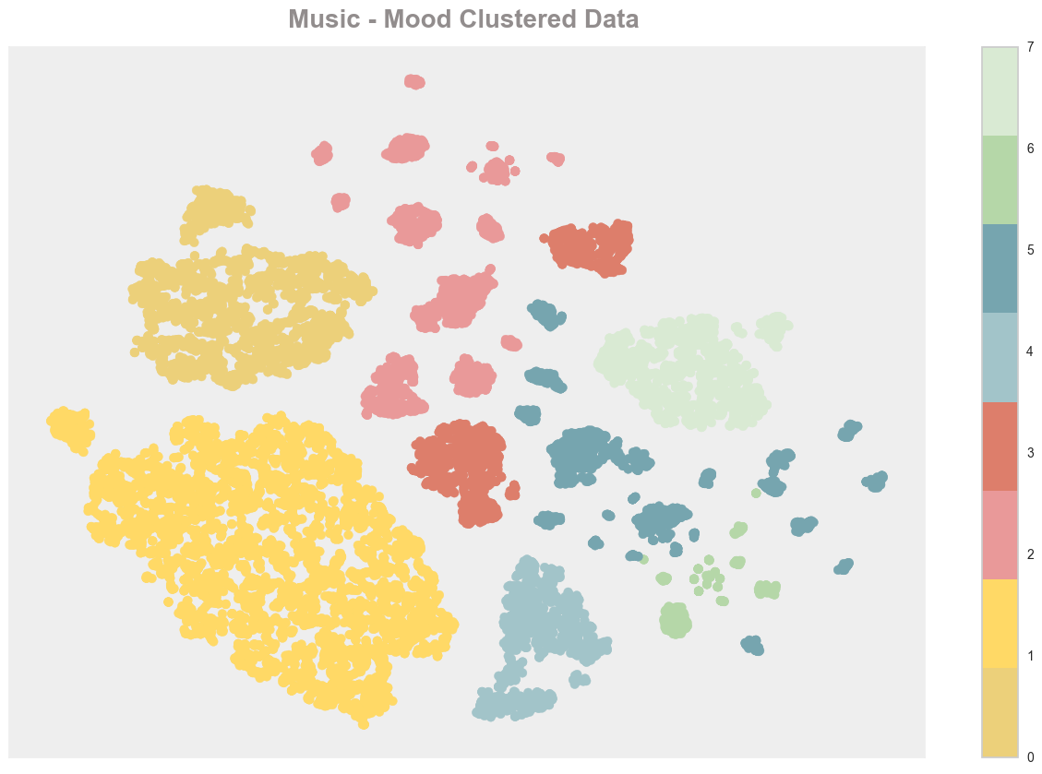
Evaluation results and error analysis
73%
Baseline
79%
Our Model
Notes:
For the modelling and evaluation, The models were trained on 15000 samples of the mood based music data with relevant audio features and genre
We trained and compared our model to our baseline so we could evaluate how well our model was able to predict the right mood clusters into which each tracks belong to and how close the are to the actual target labels
As observed during evaluation, based on the scoring metrics used #(e.g rand score & silhouette coefficient)
Our model did better in performance than our baseline and was ahead by approximately 6%
This is because our model was able to make recommendations which were more closely related to the actual mood clusters of the music tracks than the baseline even if as observed there seems to be some overlaps in some mood clusters ways based on the mood - music tracks.

Slide 23
Moosic recommendations: Relaxed and Pop
Recommended Tracks | Associated Mood | Associated Genre
Wabash Cannonball | calm | folk
Magic Mirror | calm | folk
Jungle Blues | relaxed | jazz
Limbo Rock | euphoric | pop
Kolly Haga | sad | folk
Notes:
Now for an initial moosic recommendation based on our test user,
the system was queried based on the user’s preferences
which were mood goal as relaxed and genre as pop.
The test user asked our recommender to give 5 random tracks out of the mood clusters of our data
It was observed that track ‘jungle blues ‘ being the most similar to the true relaxed mood label
and two other tracks still belonging to a similar mood quadrant split as relaxed
In general, based our evaluations the recommendations were related to the actual moosic clusters
Next, my colleague Shahi will introduce our product.

Slide 24
Web Application
User Interface
Notes:
Thank you, Grace!

Slide 25
MOOSIC
Your Mood.
Your Music.
21.08.2023
Capstone Project
neuefische Data Practitioner
https://moosic.winderling.net
Notes:
Let’s jump to the web app!

Slide 26
The End
Thank you
for your audience

Slide 27
Future Work
To be continued …
Notes:
Thank you, Grace!

Slide 28
Future Work
Modelling:
Train on a bigger sample size
Put in all the tracks to see how the clustering will look (As of now clustering patterns change because tracks are randomly chosen for the sample).
Evaluation
We used the
Use other offline metrics like the Normalised mutual
Automation, Workflow Orchestration and other services
Airflow
Spark
Nifi/+Kafka
Docker + Kubernetes
Etc

Slide 29
2. Feature engineering - MOOD
Alternative approaches
Alternatively, music can be assessed on the three dimensions of "arousal", "valence", and "depth".^{[19]} Arousal reflects physiological processes such as stimulation and relaxation (intense, forceful, abrasive, thrilling vs. gentle, calming, mellow), valence reflects emotion and mood processes (fun, happy, lively, enthusiastic, joyful vs. depressing, sad), and depth reflects cognitive processes (intelligent, sophisticated, inspiring, complex, poetic, deep, emotional, thoughtful vs. party music, danceable).^{[19]} These help explain why many people like similar songs from different traditionally segregated genres.^{[1}
Danceability
Energy
Valence

Slide 30
Extra and Credits

Slide 31
Web App - Flowchart
Click “Try me”
View “Mood-Genre-Page”
Click “Show me Tracks”
Model makes predictions
View
“Results Page”
Click
“Track”
Notes:
In slide you can see the flow of our web application.

Slide 32
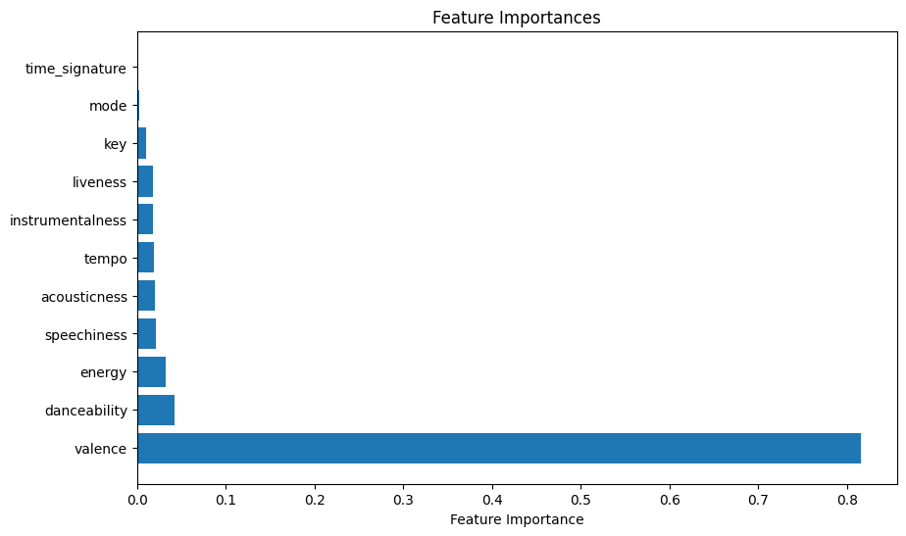
FAQ-Slide:
Feature importance for generating Mood classes

Slide 33
Genre
Mood
‹#›
Notes:
Intro to the Dataset and Highlights
We used the 600k+ dataset from spotify. It consists of two datasets: the tracks dataset and the artists dataset. Our goal is to use Mood and Genre as key features in our ML Model.So we needed to make sure to have all the features in our dataset. Lucky for us after combining the two datasets we had everything we needed to engineer our key features.
Meta-information
Title: Spotify Dataset 1921-2020, 600k+ Tracks
Subtitle: Audio features of 600k+ tracks, popularity metrics of 1M+ artists
Source: Spotify Web API
Creator: Yamac Eren Ay
Release Date (of Last Version): April 2021

Slide 34
Credits
Icons:
Slides 5-7:
<a href="https://www.flaticon.com/free-icons/listening" title="listening icons">Listening icons created by Freepik - Flaticon</a>
<a href="https://www.flaticon.com/free-icons/hip-hop" title="hip hop icons">Hip hop icons created by Flat Icons - Flaticon</a>
<a href="https://www.flaticon.com/free-icons/student" title="student icons">Student icons created by Iconjam - Flaticon</a>
<a href="https://www.flaticon.com/free-icons/emotions" title="emotions icons">Emotions icons created by Freepik - Flaticon</a>
<a href="https://www.flaticon.com/free-icons/mood" title="mood icons">Mood icons created by Flat Icons - Flaticon</a>
<a href="https://www.flaticon.com/free-icons/anger" title="anger icons">Anger icons created by wanicon - Flaticon</a>
<a href="https://www.flaticon.com/free-icons/speech-bubble" title="speech bubble icons">Speech bubble icons created by iconixar - Flaticon</a>
<a href="https://www.flaticon.com/free-icons/coordination" title="coordination icons">Coordination icons created by Freepik - Flaticon</a>
<a href="https://www.flaticon.com/free-icons/question-mark" title="question mark icons">Question mark icons created by Freepik - Flaticon</a>
<a href="https://www.flaticon.com/free-icons/angry" title="angry icons">Angry icons created by Freepik - Flaticon</a>
Credit: https://www.titanui.com/117730-150-tech-design-stack-icons-figma/ (slide 10)
<a href="https://www.flaticon.com/free-icons/machine-learning" title="machine-learning icons">Machine-learning icons created by Eucalyp - Flaticon</a>
‹#›

Slide 35
‹#›

Slide 36



Alternative resources
Here’s an assortment of alternative resources whose style fits the one of this template:
Vectors
Instagram posts collection world music day celebration

